Slide 1
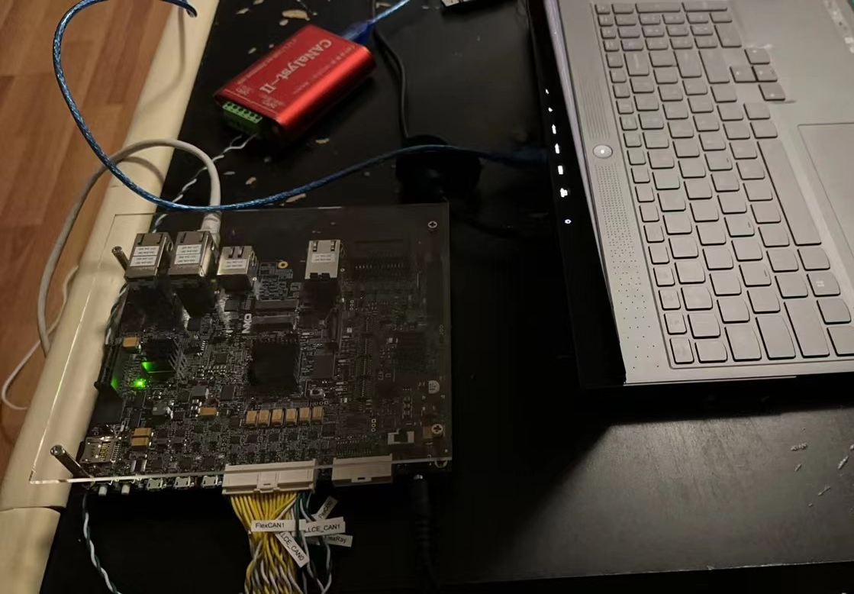

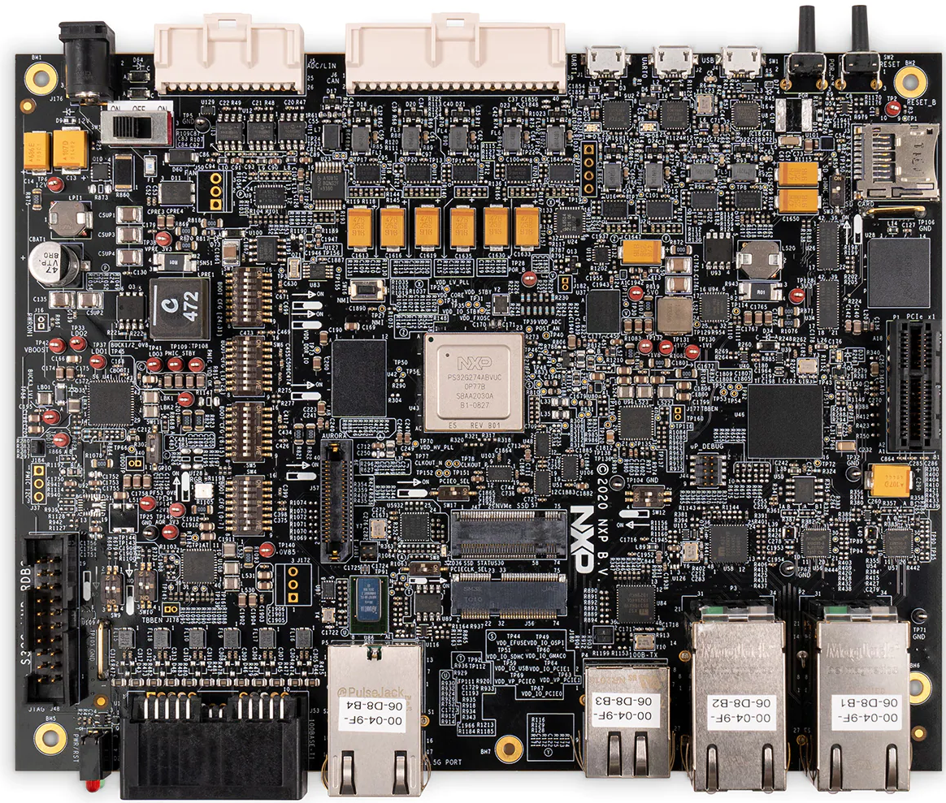
FlexCAN0
/etc/aws-iot-fleetwise/config-0.json
USB2CAN
CARLA Server
S32G-VNP-RDB2
aws iotfleetwise list-decoder-manifests
aws iotfleetwise list-decoder-manifest-network-interfaces --name

Slide 2





AWS IoT FleetWise
S32G-VNP-RDB2
AWS IoT Core
Amazon Timestream
Amazon Managed Grafana
Amazon S3
CARLA Server

